Slide 1
Optimizing Zoo Visits with Dijkstra's Algorithm
Clayton Cox

Slide 2
Objective
Visitors to the San Diego Zoo often have only one day to experience the wide array of exhibits. With limited time and a desire to see their favorite animals, planning an optimal route through the zoo can be challenging. The goal is to maximize the visitors' time by guiding them through the zoo in the most efficient manner. To achieve this, we model the zoo as a graph where each exhibit is a node and the edges represent the average time it takes to travel between exhibits. By incorporating a ranking system where visitors can prioritize their favorite animals, we can adjust the edge weights using a multiplier (e.g., multiplying the rank by 5). This adjustment ensures that the optimized route favors paths leading to higher-ranked exhibits, providing a personalized and time-efficient visiting experience.

Slide 3
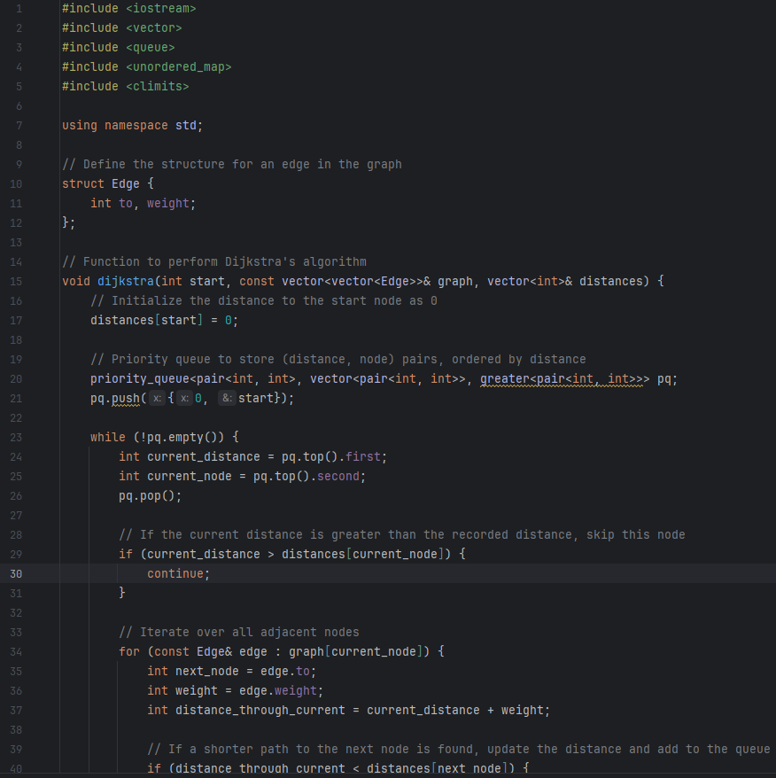
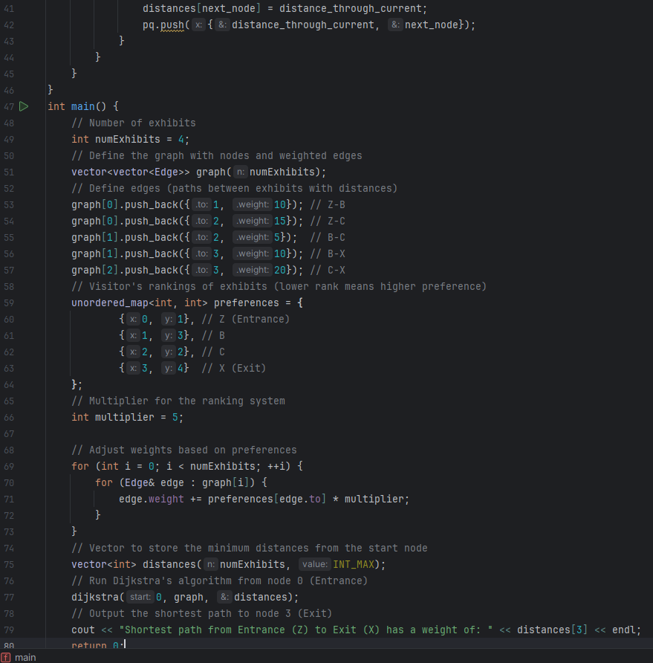

Slide 4
Code Explanation
The code implements Dijkstra's algorithm to find the shortest path through the zoo based on visitors' personalized rankings of the exhibits. Initially, the zoo is represented as a graph with nodes as exhibits and edges as paths between them, each having a weight that denotes the travel time. Visitors rank their preferred exhibits, and these rankings are used to adjust the edge weights. Specifically, the rank of each exhibit is multiplied by a chosen value (e.g., 5) and added to the edge weight, reflecting the visitor's preference. The adjusted weights ensure that the algorithm prioritizes paths leading to higher-ranked exhibits. Dijkstra's algorithm then calculates the shortest path from the entrance to the exit, considering the adjusted weights, thus providing an optimized route tailored to the visitor's preferences. The result is a path that maximizes the visitor's experience within their limited time at the zoo.

Slide 5
